Slide 1
Quick Tutorial to configure AWS SES for Bulk Send Mail
Andre Marzulo | Solution Engineer| April 2018

Slide 2
Agenda
1 | Pre-Requirements
2 | Email Confirmation
3 | Configuration Sets
4 | Email Templates
5 | Sending e-mails
7 | Artifacts

Slide 3
Pre-Requirements
Configure AWS CLI on your computer. Follow the instructions available here:
https://docs.aws.amazon.com/cli/latest/userguide/installing.html
Configure AWS account and access to console: https://console.aws.amazon.com
Configure the AWS CLI to connect on your AWS account, following the instructions available here:
https://docs.aws.amazon.com/cli/latest/userguide/cli-chap-getting-started.html
Choose a nice E-Mail template. My choice was Email Octopus available here:
https://emailoctopus.com/features#templates
Fancy Text Editor installed on your computer. On Mac, I use TextWrangler and vi.
Github CLI installed (optional)

Slide 4
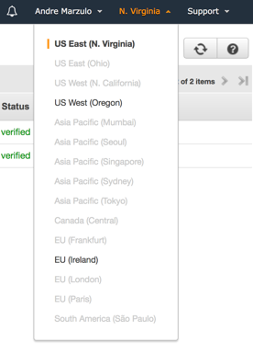
E-Mail Address confirmation
Open the Simple Email Service console and choose the Region (Up Right Corner)

Slide 5
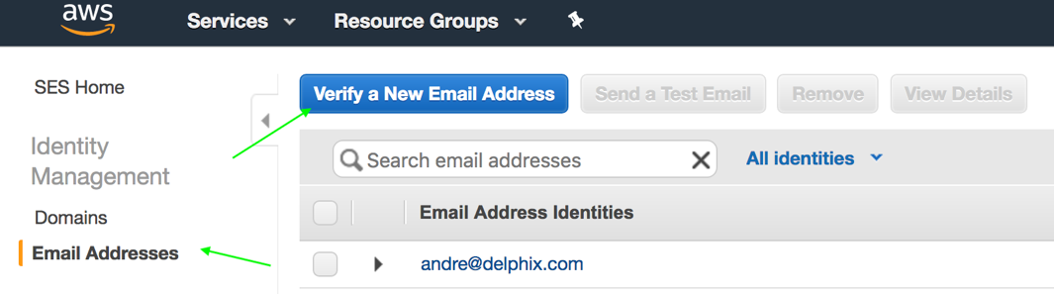
E-Mail Address confirmation
On the left side click on Email Addresses and then Verify a New Email Address button:
This is to begin test your process with your own email address.
You will receive a link in your email that you should click and validate

Slide 6
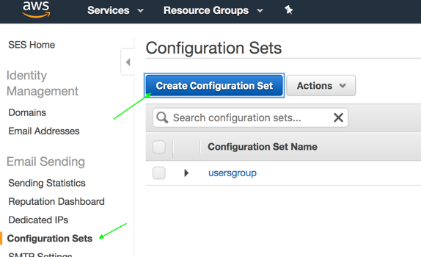
Enable a Configuration Set
On the left side click on Configuration Sets and type a name that make sense to you:
Configuration Set is necessary if you wish to threat Bounces, and is not our case here.

Slide 7
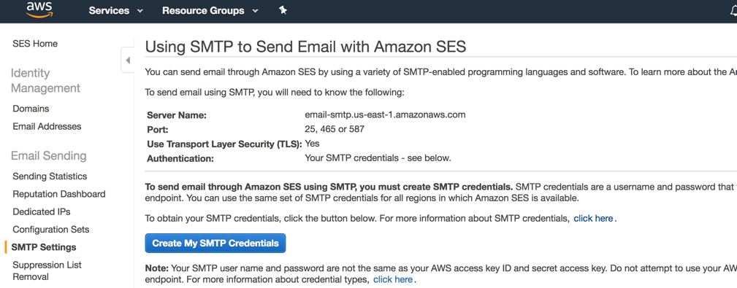
SMTP Settings
You can use the SMTP AWS server to send emails using your own email clients. You can get credentials and more details on SMTP Settings screen:

Slide 8
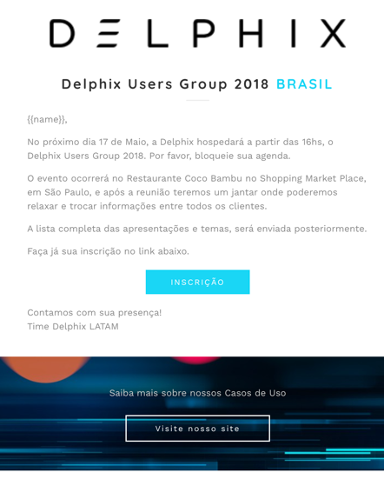
E-Mail Templates
You can create a beautiful and responsive html, or you can reuse one from Internet
I used one from Internet. Using the Octopus, I edited the HTML configuring the images with Delphix standard pictures.
I use pictures from our public website, to not embed pictures in the e-mail.
If you wish a replaceable text on the email, use {{word}} variable. In my example, I made the name variable.
You can see the detailed html file, in the artifacts.

Slide 9
E-Mail Template conversion to JSON
The HTML conversion to JSON requires some characters replacement. Using my Text Editor I replaced the HTML file with this 2 rules:
Remove End Of Lines. Using Replace feature Find for "\n" (without quotes) and Replace empty.
Insert slash before quotes. Find: " Replace: \"
You can use VIM too, typing following commands on the HTML file:
:%s/\n//g (Removing End Of Lines)
:g/\"/s//\\\"/g (Adding \ slash before " quotes)
You will use this line in the next file.

Slide 10
E-Mail Template JSON preparation
Create a file with json extension, with the content below:
{
"Template": {
"TemplateName": "usersgroupmodelo1", (Name of the template to be used on AWS CLI)
"SubjectPart": "Convite para o Delphix Users Group 2018 - Brasil!", (Email Subject)
"HtmlPart": "html/json code" (paste here the HTML converted to JSON from the prior slide)
}
Save the file and we will load AWS SES with this Template

Slide 11
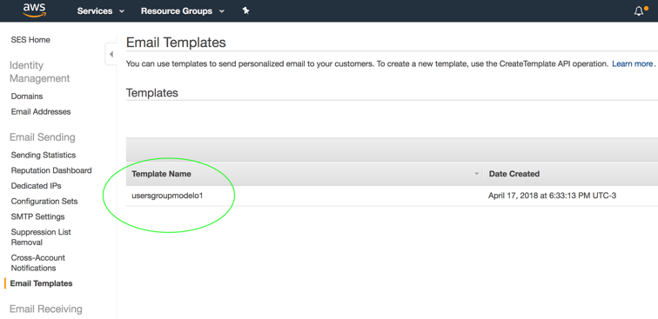
E-Mail Template configuration on AWS
I am assuming you configured you AWS CLI to access your account, using aws configure command.
Now, you go to the json file location in the terminal, and type:
aws ses create-template --cli-input-json file://<file_name_model>.json
If a error occurs you will receive a message. If not, you can validate the Template Name on AWS SES Console:

Slide 12
E-Mail Bulk list configuration – Small test
Now, let's create a JSON file with the recipients to receive the sending mail, using the following structure:
{
"Source": "your_verified_email@delphix.com", (see slide 5)
"Template": "usersgroupmodelo1", (template name defined on slide 10)
"ConfigurationSetName": "usersgroup", (see slide 6)
"Destinations":[
{
"Destination":{
"ToAddresses":[
"another_verified_email@gmail.com"
]
},
"ReplacementTemplateData":"{ \"name\":\"Andre\"}" (see slide 8 for more detail of replacement)
},
{
"Destination":{
"ToAddresses":[
"another_verified_email@delphix.com"
]
},
"ReplacementTemplateData":"{ \"name\":\"Marzulo\"}"
}
],
"DefaultTemplateData":"{ \"name\":\"Dear\"}" (This replacement is used as Default value)
}

Slide 13
E-Mail Bulk list Sending – Small test
Now we will execute a Bulk Sending. The intention is validate that the email is well configured and responsive (appears ok on the computer and/or cell phone).
Go to working directory, where resides the JSON file with the emails configured and type:
aws ses send-bulk-templated-email --cli-input-json file://<emails_file>.json
This will send the e-mails to your validation.
If you wish to edit your template, you will need to repeat slides 8, 9 and 10.
After this, instead of create a new template, you will Update the current template, with the following command:
aws ses update-template --cli-input-json file://<file_name_model>.json

Slide 14
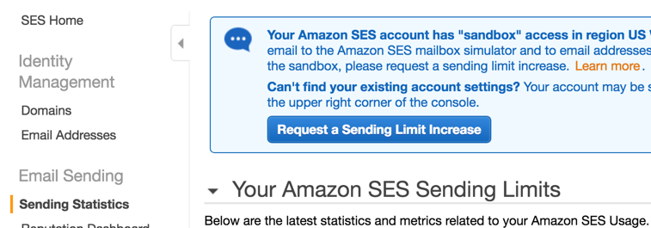
Changing your email Sending Limits
Now we need to open a request to AWS Support to increase the email Sending Limits, since we worked on one Sandbox environment, which allows you only send e-mail to Verified e-mails.
You should Click on Sending Statistics, and then click on the button Request a Sending Limit Increase:

Slide 15
Changing your email Sending Limits
In the Support Request, is important to explain in detail what you are planning to achieve.
In my example, I wrote this on the ticket:
Use case description: This is an Event Invitation sent to our current clients in Brasil. This event refers to an Delphix Users Group 2018. The e-mail list is obtained from our support page where only existent client have access using their professional e-mail.
The field FROM will be my Professional verified e-mail: andre@delphix.com.
I will not handle bounces and complaints because I don't need this. ALL the e-mail is mapped and confirmed on our systems. I will personally talking with the invitees if the e-mail didn't arrives the destination. I am planning to send those invitations just once.
AWS take around 12 hours to answer this request.

Slide 16
E-Mail Bulk list Sending – For Real
The Real Bulk send can handle 50 emails per JSON file. If you need to send more than 50 emails, you will need to configure multiples files.
I wrote a script (printjson.c or printjson.py) which read a file with "<email> <name>\n" format (listamail.txt) that generates those emails files. You can see in artifacts.
With the files ok, is just execute following command for each file, and the Bulk emails was sent:
aws ses send-bulk-templated-email --cli-input-json file://<emails_file>.json

Slide 17
Artifacts
Please visit: https://github.com/marzulo/AWS_SES_artifacts.git
In your Terminal, create a new directory and type:
git init
git pull https://github.com/marzulo/AWS_SES_artifacts.git

